Slide 1
Project Update – Week 2
Tora Gao, Zheng Shi, Leon Zhang

Slide 2
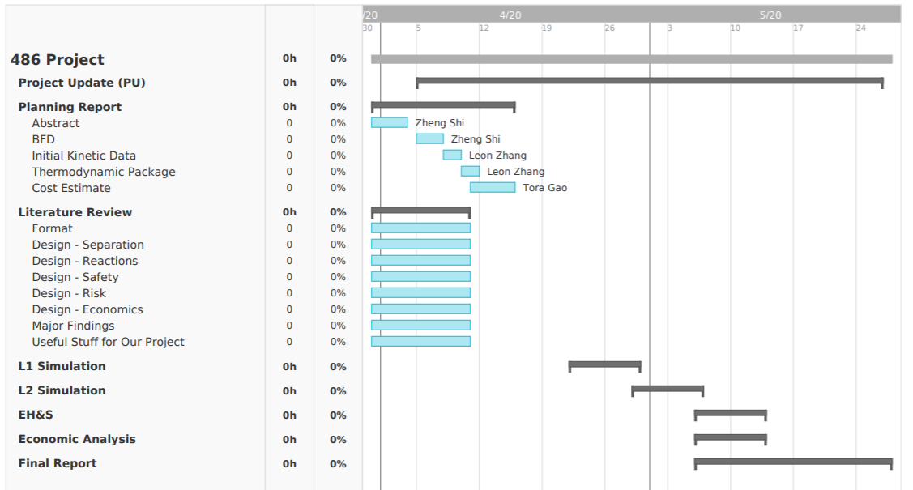
Gantt Chart
Notes:
https://prod.teamgantt.com/gantt/schedule/?ids=2115888#&ids=2115888&user=&custom=&company=&hide_completed=false&date_filter=&color_filter=

Slide 3
Tasks Completed
Findings for the upstream process
H2 Production
Electrolysis
N2 Production
Membrane
Cryogenic Distillation
Pressure Swing Absorption
Findings for the downstream process
NH3 Production
Small Scale Haber-Bosch
Non-Thermal Plasma Catalysis
Water Gas Shift Reaction

Slide 4
Unexpected Hurdles and Potential Solutions
Hurdles:
Kinetic information
Potential difficulty to simulate electrolysis process in Aspen
Solutions:
Find kinetic information in literature
Prof. Stuve can provide Excel sheet for electrolysis process of upstream

Slide 5
Short-Term and Long-Term Plans
Short-Term
Literature review
Decide on overall process structure
Complete planning report and its components
Identify how to simulate each process component (specifically electrolysis, reactor, and N₂ production)
Long-Term
Be able to simulate process in Aspen (downstream and upstream)
Decide on modular manufacturing method and unit capacity
Start L1 simulation

